Slide 1
The Wordwall-Based Gamification in Teaching English Vocabulary
By : Dina Triana Febrianti (218820300010)
Advisor : Wahyu Taufiq S.Pd., M.Ed
English Language Education
Faculty of Psychology and Educational Sciences
University of Muhammadiyah Sidoarjo
July, 2025

Slide 2
Introduction
Background of The Study
Vocabulary
Vocabulary is an essential component of any language that needs to be fully understood. Inadequate vocabulary mastery significantly impacts language proficiency in spelling, pronunciation and proper word selection. Students need to apply their skills and must create strategies for their own vocabulary growth.
Gamification
Gamification is a game-inspired learning technique for gaining knowledge and skills. Gamification incorporates game features into learning design across a wide range of fields and subjects. Gamification offers a boost to ensure that students are engaged in a comprehensive learning experience.

Slide 3
Introduction
Background of The Study
Wordwall
Wordwall is an educational entertainment website that provides a variety of games for student learning to make it less monotonous and more fun. By using Wordwall, students can memorize more vocabulary without feeling too serious in learning.

Slide 4
Introduction
Data collection Gap
Previous Research | This Research
The research conducted by Asti (2023) using game-based Wordwall media on student learning outcomes The research conducted by Rohmatin (2023) use of Wordwall-based educational games to improve students’ vocabulary skills The research conducted by Anindyajati (2017) using Wordwall media to improve science-based vocabulary | This research will focus on the application of gamification method on Wordwall learning media in improving vocabulary in English subject.

Slide 5
Introduction
Novelty
This study is expected to find out more about the vocabulary mastery of seventh grade students that has not been explored in depth in previous studies. This study is different from the previously mentioned studies (target students). Previous studies included elementary school students, and students with special needs (SLB). This study focuses on superior students in grade VII of junior high school. This study presents an innovative perspective in using Wordwall-based gamification to improve vocabulary learning among junior high school students.

Slide 6
Research Question
how the use of Wordwall-based gamification strategies improves
elementary school students' English vocabulary mastery?

Slide 7
Methods
Design
This research use quantitative pre-experimental design methods
Research Participants
Participants of this study were students from a one class
The sample consisted of 22 students
Research in April
This research conduct at Junior High School in Krian, Sidoarjo
Data collection techniques
From the results with pretest – treatment (using WordWall method) – posttest
Data analysis techniques
Descriptive statistics: analyzing pre and post test scores
inferential statistics: using paired-sample t-test

Slide 8
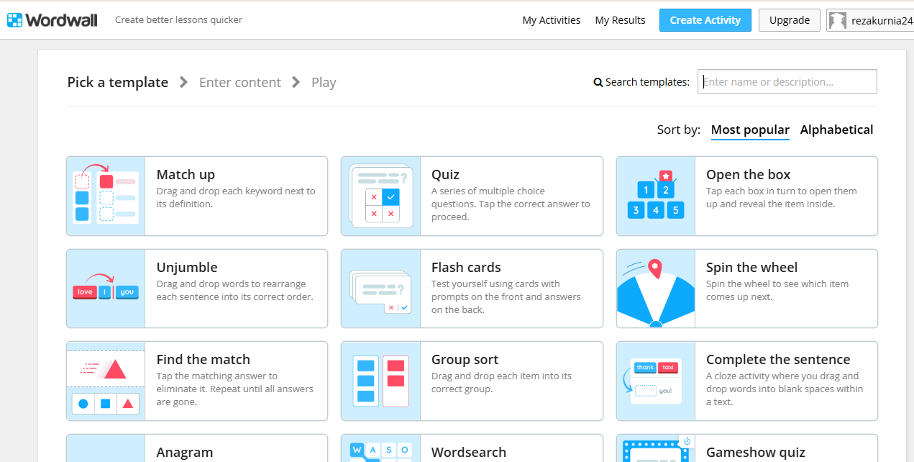
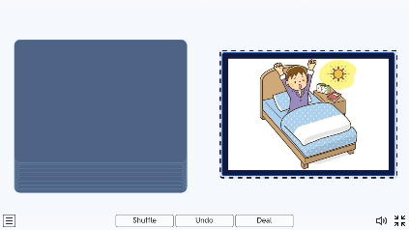
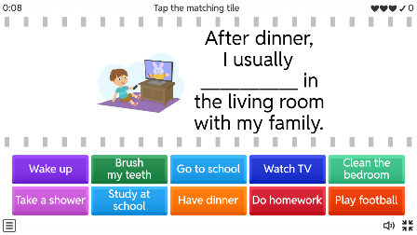
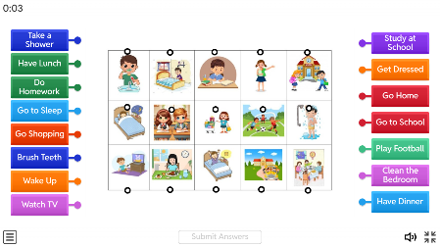
The Appearance of Wordwall

Slide 9
Findings
Tabel 3. Descriptive Statistics
 |  | Mean | N | Std. Deviation | Std. Error Mean
Pair 1 | Pretest | 52.27 | 22 | 16.015 | 3.414
 | Posttest | 85.23 | 22 | 10.632 | 2.267
the results of descriptive statistics describing the pretest and posttest scores of 22 students, it is clear that before the intervention or before being given treatment, the average score of students was (M = 52.27). After being given treatment using the Wordwall application in the learning process, the average score of students increased to (M = 85.23). This shows that after using Wordwall as a gamification-based learning media in the classroom, students' vocabulary mastery increased.

Slide 10
Findings
Tabel 4. Tests of Normality
 | Kolmogorov-Smirnovª |  |  | Shapiro-Wilk
 | Statistic | df | Sig. | Statistic | df | Sig.
Pretest | .147 | 22 | .200* | .940 | 22 | .194
Posttest | .099 | 22 | .200* | .938 | 22 | .183
*. This is a lower bound of the true significance.
a. Lilliefors Significance Correction
The results of the normality test are shown in the table 4 above. The significant value for the pre-test is 0.194 and for the post-test is 0.183. This shows that the measured significance value is higher than 0.05 (> 0.05), so it can be concluded that the pre-test and post-test values of the experimental class are normally distributed.

Slide 11
Findings
Table 5. Paired Samples Test
 |  | Paired Differences |  |  |  |  | t | df | Sig. (2-tailed)
 |  | Mean | Std. Deviation | Std. Error Mean | 95% Confidence Interval of the Difference
 |  |  |  |  | Lower | Upper
Pair 1 | Pretest - Posttest | -32.955 | 14.692 | 3.132 | -39.469 | -26.440 | -10.521 | 21 | .000
The analysis presented in table 5 shows significant findings regarding the comparison between the pre-test and post-test results regarding students' vocabulary mastery when using conventional media compared to Wordwall. Statistical significance is indicated by the Sig. (2-tailed) value of 0.00 which is smaller than 0.05 (0.00 < 0.05). This result implies that there is a significant difference in students' vocabulary mastery before and after being exposed to the teaching method.

Slide 12
Discussion
These findings indicate that Wordwall is able to create a more interactive and enjoyable learning atmosphere, encouraging students to be more active and motivated in participating in learning. In addition, the gamification approach applied has been proven to be able to overcome boredom in conventional learning and increase student memory and participation. These results also support the findings of previous studies which state that the use of digital game-based learning media such as Wordwall can increase student engagement and academic achievement, especially in English vocabulary mastery.

Slide 13
Conclusion
this study states that the use of Wordwall media is effective in improving students' English vocabulary mastery. Through the gamification approach, learning becomes more interactive, fun, and can improve students' motivation and learning outcomes. Wordwall can be used as an alternative learning media that is in accordance with technological developments and students' needs in the digital era.

