Slide 1
The Effect of Gamification in Board Game to Improve English Vocabulary in Junior High School
Oleh:
Syahfrina Rahmawati,
Vidya Mandarani
Pendidikan Bahasa Inggris
Universitas Muhammadiyah Sidoarjo
Juli, 2023

Slide 2
Introduction
THE IMPROTANT OF VOCABULARY
English consists of four skills : Productive Skills (Active Skills) & Receptive Skills (Passive Skills) (C. Sharma 2021).
According to (D. Andriani & V. Sriwahyuningsih 2019). Englishconsists of language components : Vocabullary, Grammar, Pronounciation, and Spelling.
Vocabulary is the basic of learning a language according to (Rohmatilah 2010).

Slide 3
Introduction
CHARACTERISTIC OF STUDENTS
To attract the students’ attention in learning.
The "Merdeka Belajar" Curriculum
Gamification is a game-based learning method

Slide 4
Research Objective
to find out whether board game media using gamification method can improve English vocabulary skills contained in descriptive text of seventh grade students of MTS Muhammadiyah 1 Taman.

Slide 5
Indicator of Gamification

Slide 6
Indicator of Gamification

Slide 7
Research Hypothesis
There is an increase in English vocabulary skill given descriptive text learning with Board Game media by using Gamification method.

Slide 8
Method
Research Design : Quasi Experiment (one class).
Population : All Students in VII grade at MTS Muhammadiyah 1 Taman.
Sample : VII Grade in Regular Class (Experiment) with 41 students.
Data collection : Pre-test & Post-test

Slide 9
Research Process

Slide 10
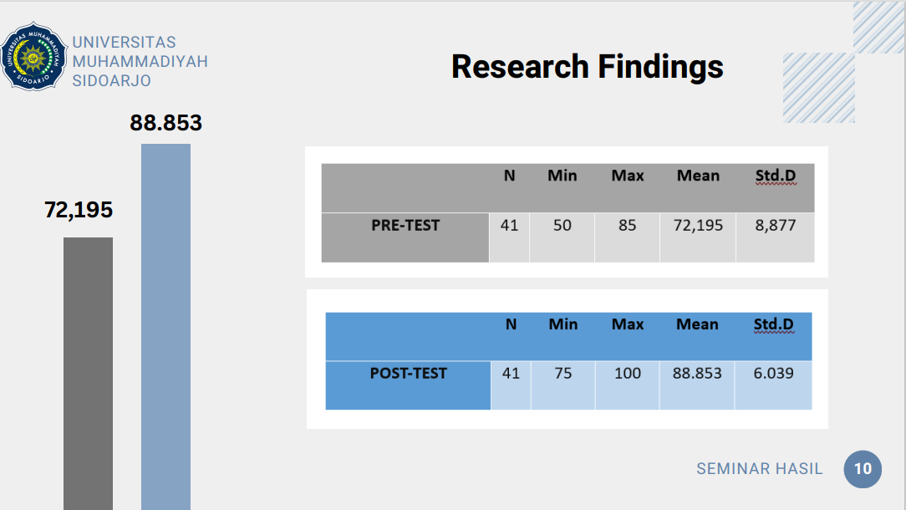
Research Findings

Slide 11
Normality Test

Slide 12
Research Hypothesis Analysis
The null hypothesis (Ho) is a hypothesis that shows there is no significant difference before (pre-test) and after (post-test) using the Gamification method learning English.
The alternative hypothesis (Ha) is a hypothesis that shows there is a significant difference before (pre-test) and after (post-test) using the Gamification method in learning English.

Slide 13
Hypothesis Test

Slide 14
Hypothesis Test

Slide 15
Discussion

Slide 16
Conclusion

Slide 17
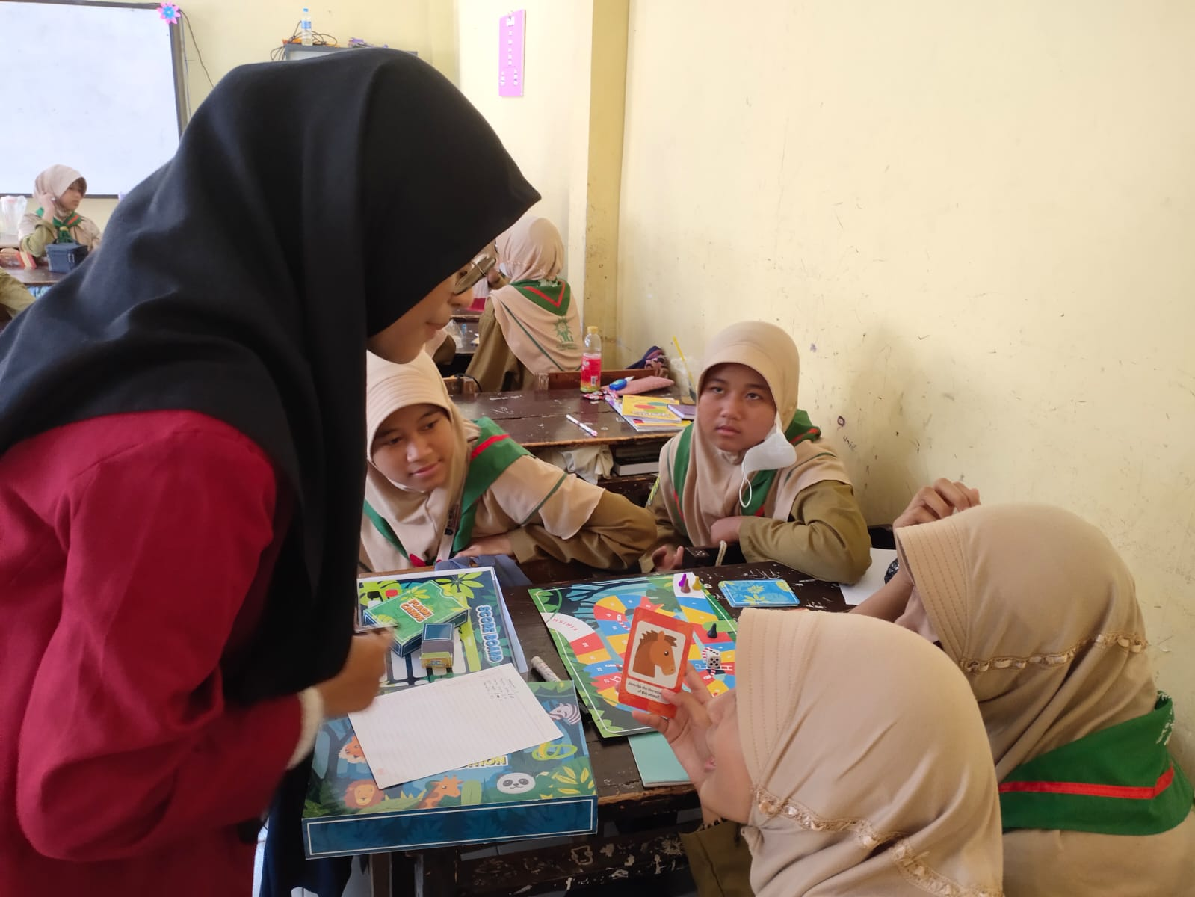
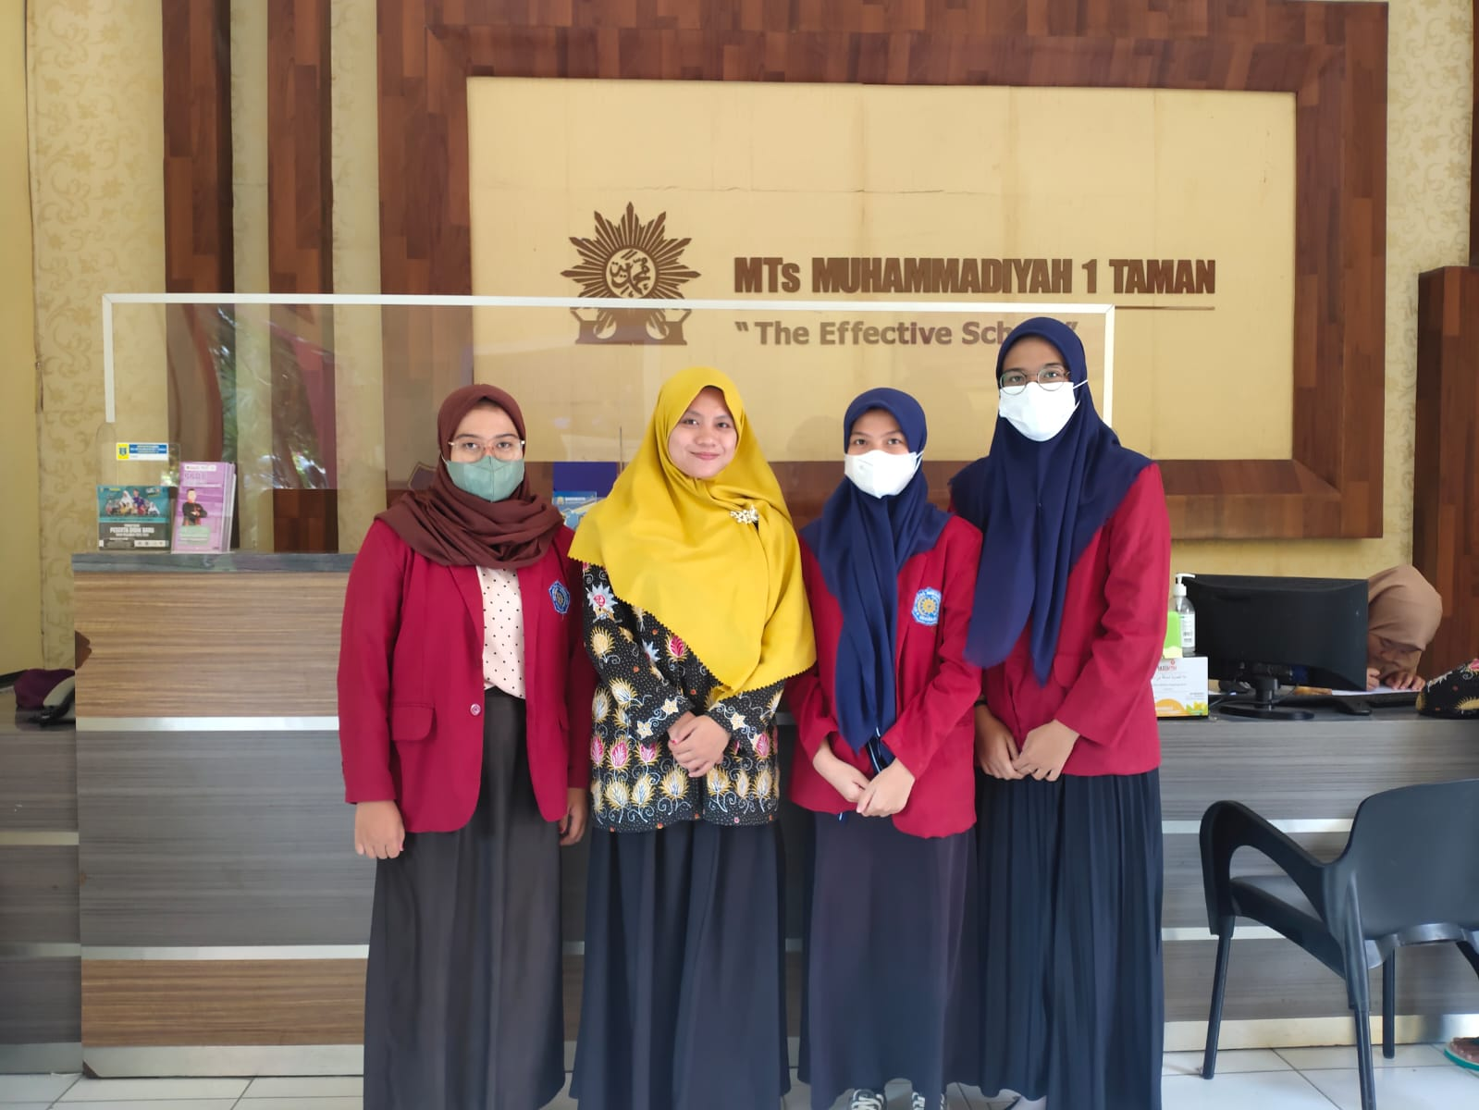
Documentations

Slide 18
Referensi
Sharma, C. (2021). The Importance Of Four Basic Skills In Learning English Learning environment View project English learning View project. February. https://doi.org/10.47211/tg.2020.v07i04.007
Merris, D., & Sari, M. (2019). THE EFFECTIVENESS OF CORRECTIVE FEEDBACK TO THE STUDENTS ’ GRAMMATICAL CONSTRUCTION Sari . The Effectiveness …. Sari . The Effectiveness …. 2(2), 122–131.
Rohmatillah. (2010). A Study On Students’ Difficulties In Learning Vocabulary. 7(c), 89–94.
Seaborn, K., & Fels, D. I. (2015). Gamification in theory and action: A survey. International Journal of Human Computer Studies, 74, 14–31.
Kemendikbud. (2016). Jendela Pendidikan dan Kebudayaan. Menteri Pendidikan Dan Kebudayaan, 33.
Welbers, K., Konijn, E. A., Burgers, C., de Vaate, A. B., Eden, A., & Brugman, B. C. (2019). Gamification as a tool for engaging student learning: A field experiment with a gamified app. E-Learning and Digital Media, 16(2), 92–109. https://doi.org/10.1177/2042753018818342

